Slide 1

云计算起源
History of Cloud computing
Notes:
At around the same time, in 1961, John McCarthy suggested in a speech at MIT that computing can be sold like a utility, like electricity or water. It looked like a brilliant idea, but like all brilliant ideas it was ahead if its time, as for the next few decades, despite interest in the model, the technology simply was not ready.
Of course time has passed and the technology caught up with the ideas and there are a few milestones we have to mention:
In 1999 Salesforce.com started delivering applications to users using a simple website. The applications were delivered to enterprises over the Internet, and the dream of computing sold as utility started being reality. Although the service was successful, some more time would pass until it would become widespread.
In 2002 Amazon started Amazon Web Services, providing services like storage, computation and even human intelligence. However, only starting with the launch of the Elastic Compute Cloud in 2006 did a truly commercial service open to everybody exist.
2009 marked a key turning point in the evolution of cloud computing, with the arrival of browser based cloud enterprise applications, with the best known being Google Apps.
Of course, all the big players are present in the cloud computing evolution, some earlier, some later. In 2009 Microsoft launched Windows Azure, and companies like Oracle and HP have all joined the game. This proves that today, cloud computing has become mainstream.
You can argue over when cloud computing really began, but one good starting point is 2006 when then Google CEO Eric Schmidt said at a conference: “I don’t think people have really understood how big this opportunity really is. It starts with the premise that the data services and architecture should be on servers. We call it cloud computing—they should be in a ‘cloud’ somewhere. And, that if you have the right kind of browser or the right kind of access, it doesn’t matter whether you have a PC or a Mac or a mobile phone or a BlackBerry or what have you – or new devices still to be developed – you can get access to the cloud.”
At about the same time, Amazon realized that to empower its core competencies in supply chain management and retail, it had gotten quite good at easily deployable infrastructure IT services such as compute, storage and database. So, Amazon’s top brass reasoned, why not profit by leasing out these services to business customers? Thus began Amazon Elastic Compute Cloud, the forerunner of Amazon Web Services (AWS).
For the next few years, AWS had the public cloud market largely to itself, shared only with a host of smaller companies. But, by 2010, the other major IT powers realized that they needed to fly into the cloud or be left grounded.
Despite Google’s early grasp of the concept, Microsoft would be the second major company to offer a major public cloud when Ray Ozzie, Microsoft’s chief software architect, announced Windows Azure in 2008. It wasn’t until February 2010 that Azure was rolled out. That year also saw the first release of the most important pure open-source Infrastructure-as-a-Service (IaaS) cloud play, OpenStack.
And Google? After an extended beta, Google App Engine, the first building block of the Google Cloud, finally arrived in November 2011.
All these clouds were built on virtual machines (VMs), and managing VMs using traditional sysadmin tools was still a bottleneck. The answer to that was the rise of DevOps. This marriage of Agile concepts with infrastructure deployment transformed system management. With the first DevOps programs, and their close relations — continuous integration, continuous delivery and continuous deployment (CI/CD) in the late 2000s and early 2010s — clouds were given the flexibility they needed to be a commercial success.
Another approach to virtualization – containers — took the stage in 2013 and would revolutionize Software-as-a-Service (SaaS) and Platform-as-a-Service (PaaS) clouds. While containers per se weren’t new, in 2013 Docker made it easy to deploy applications and servers in containers.
The next step was how to manage those containers. Kubernetes, which was released in 2015, proved to be the answer. By the decade’s end, Kubernetes had become the default container orchestration standard.
Kubernetes’s popularity has, in turn, led to the rise of hybrid clouds. Before, hybrid clouds relied on one-off middleware services to bridge public and private clouds. This wasn’t easy. Kubernetes has made building hybrid clouds easy.
While this was going on, AWS introduced the concept of serverless computing in 2014 with Lambda. In this model, application functionality is delivered not in VMs or containers, but as at-scale services within the cloud. This approach has led to the growth of cloud-native computing.
This brings us up to today. At the beginning of the last decade, the cloud was still largely misunderstood and more of a promise than a reality for most businesses. If you’d asked a CIO in 2010 if they planned to move to the cloud, they would have scoffed at the idea.
Today, as we enter the 2020s, it’s a different story. The cloud is our present. . . and our future. The question today isn’t, “Are you moving to the cloud?” It’s, “What are you going to do with your cloud?”

Slide 2
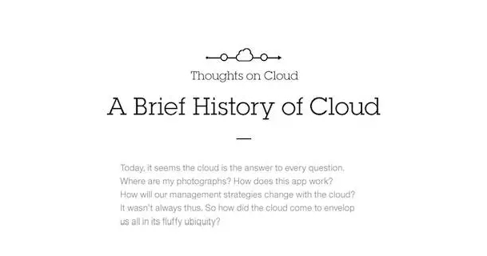
Notes:
Simply put, cloud computing is the delivery of computing services—including servers, storage, databases, networking, software, analytics, and intelligence—over the Internet (“the cloud”) to offer faster innovation, flexible resources, and economies of scale. You typically pay only for cloud services you use, helping you lower your operating costs, run your infrastructure more efficiently, and scale as your business needs change.

Slide 3
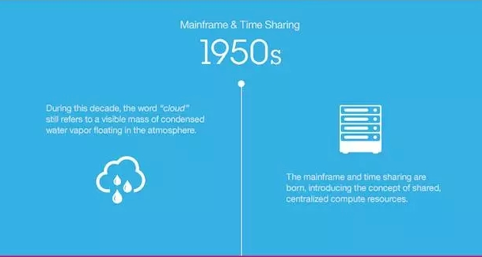
1950s--MAIN frame &time sharing
Notes:
上世纪50年代 大型机与分时
在这个十年，“云”这个词仍指飘浮在大气中的一团看得见的冷凝水蒸汽。大型机和分时技术诞生，引入了共享集中式计算资源这个概念。

Slide 4
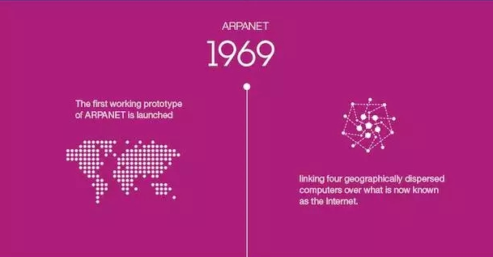
Newborn--ARPAnet
Notes:
1969年 阿帕网（ARPANET）
阿帕网（ARPANET）的第一个实用原型问世，它通过如今名为互联网的网络系统将四台地理上分散的计算机互联起来。

Slide 5
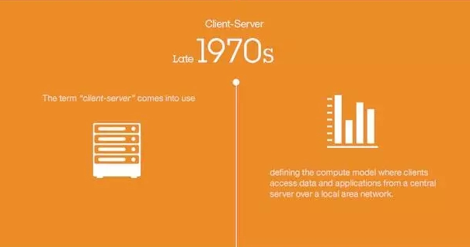
Client-server
Notes:
上世纪70年代末期 客户机/服务器
“客户机/服务器”这个术语开始得到使用，定义了这种计算模式：客户机通过局域网，访问来自中央服务器的数据和应用程序。

Slide 6
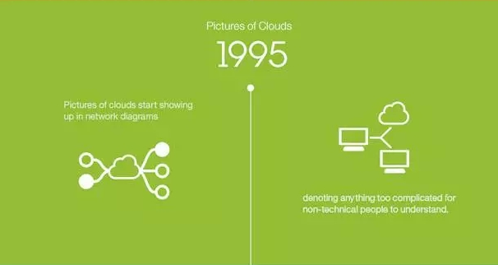
Clouds?
Notes:
1995年 云图形
云图形开始出现在网络图中，代表任何太过复杂、非技术人员无法明白的系统。

Slide 7
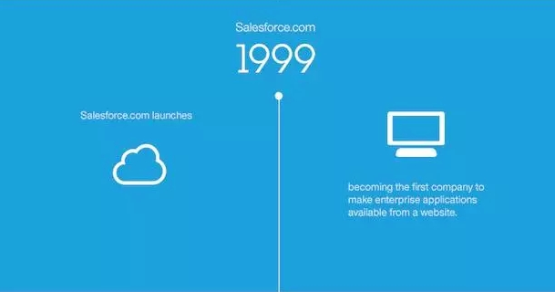
saas
Notes:
1999年 Salesforce.com
Salesforce.com成立，成为第一家通过网站提供企业应用程序的公司。

Slide 8
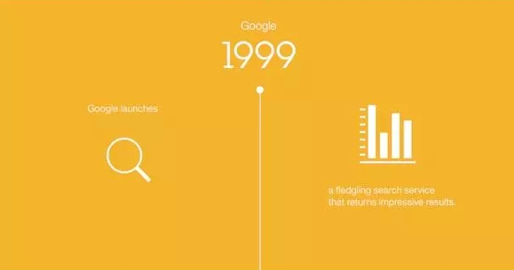
Google
Notes:
1999年 谷歌
谷歌成立，这项新兴的搜索服务可以返回海量搜索结果。

Slide 9
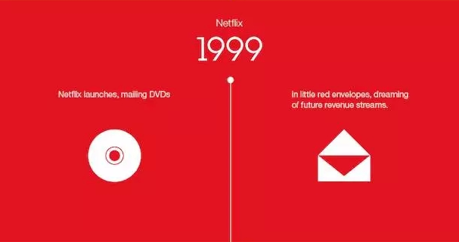
netflix
Notes:
1999年 Netflix
Netflix成立，用小小的红色信封邮寄DVD，梦想未来能获得源源不断的收入。2000亿

Slide 10
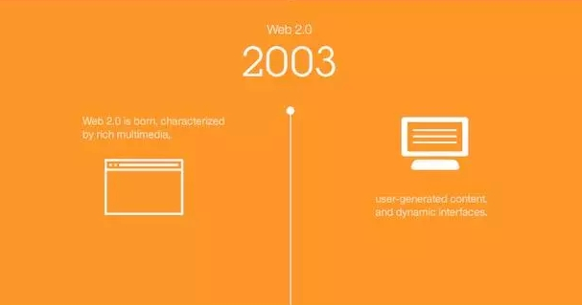
Web 2.0
Notes:
2003年 Web 2.0
Web 2.0问世，以丰富多媒体、用户生成的内容和动态界面为特点。

Slide 11
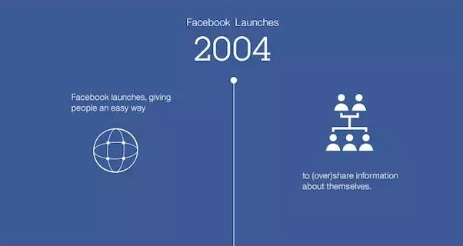
facebook
Notes:
2004年 Facebook成立
Facebook成立，为人们提供了一种（过度）共享个人信息的方法。

Slide 12
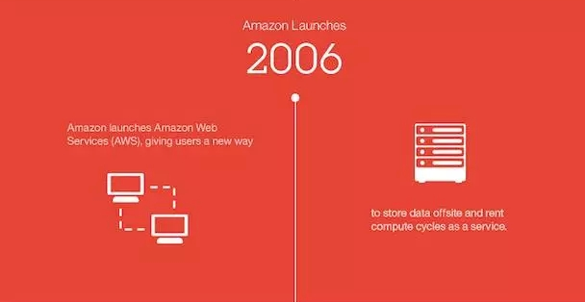
amazon
Notes:
2006年AWS成立
亚马逊公司成立了亚马逊网络服务（AWS），为用户提供了一种将数据存储在异地，并租用计算周期的新方法，这成为了一项服务。

Slide 13
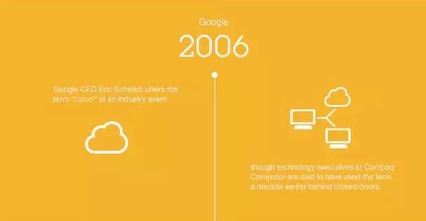
Cloud computing
Notes:
2006年 谷歌
谷歌首席执行官Eric Schmidt在一次行业活动上首次使用了“云”这个术语，不过据说康柏公司的技术主管们早十年前就在小圈子使用这个术语了。

Slide 14
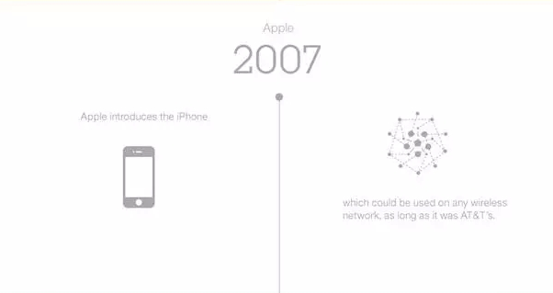
iphone
Notes:
2007年 苹果
苹果推出了iPhone，这款手机可以在任何无线网络上使用，只要是AT&T的网络。

Slide 15
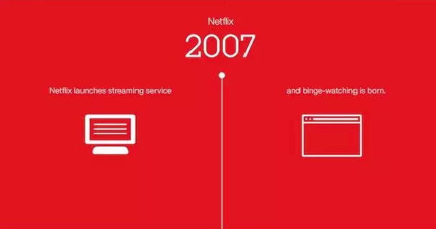
Streaming service
Notes:
2007年 Netflix
Netflix推出了流媒体服务，狂看（即连续观看，binge watching）概念由此诞生。

Slide 16
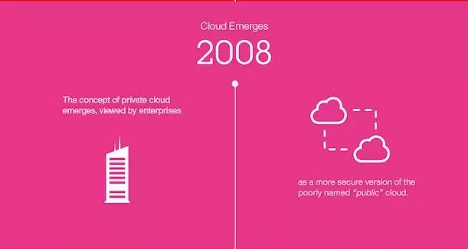
Private cloud
Notes:
2008年 云出现
私有云概念问世，被众多企业认为是名字取得很差劲的“公共”云的一种较安全的版本。

Slide 17
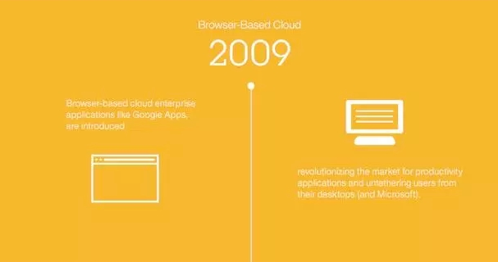
paas
Notes:
2009年 基于浏览器的云
以谷歌应用程序（Google Apps）为代表的基于浏览器的云企业应用软件发布，彻底改变了办公应用软件市场，并解放了广大用户，从此摆脱了桌面（和微软产品）的束缚。

Slide 18
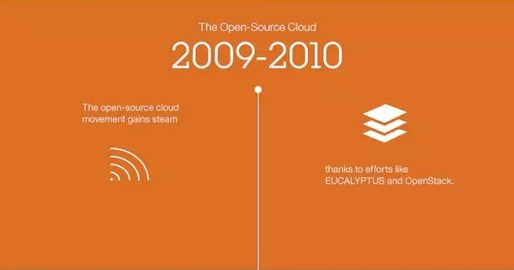
Open source cloud
Notes:
2009年至2010年 开源云
开源云潮流势头越来越猛，这归功于Eucalyptus和OpenStack等开源项目。

Slide 19
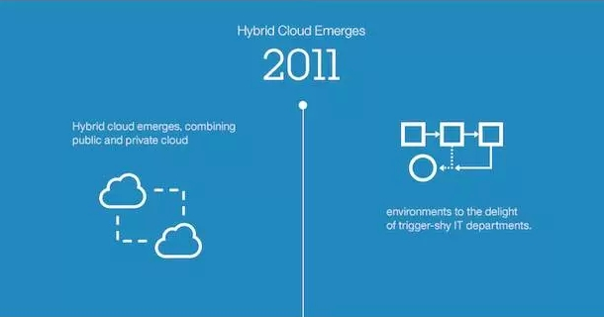
Hybrid cloud
Notes:
2011年 混合云出现
混合云出现，它结合了公共云环境和私有云环境，这让优柔寡断的IT部门大为高兴。

Slide 20
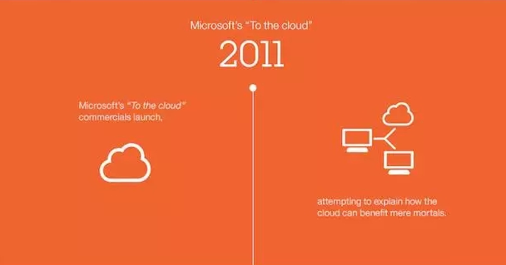
To the cloud
Notes:
2011年 微软“To the cloud”广告亮相
微软的“To the cloud”广告亮相，试图解释云能如何惠及普通人。

Slide 21
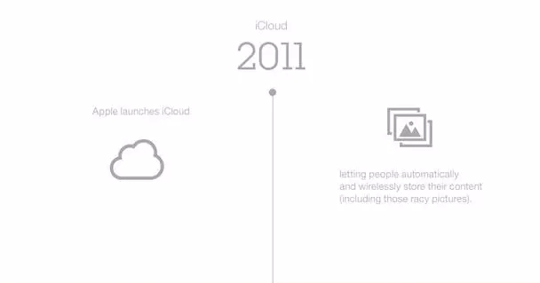
icloud
Notes:
2011年 iCloud
苹果发布iCloud，让人们可以自动以无线方式存储其内容（包括那些劲爆的照片）。

Slide 22
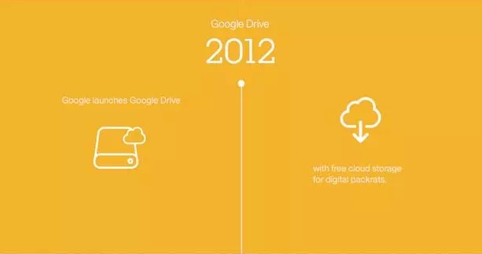
Cloud storage
Notes:
2012年 Google Drive
谷歌发布Google Drive，为喜欢收集数据的人提供了免费的云存储空间。

Slide 23
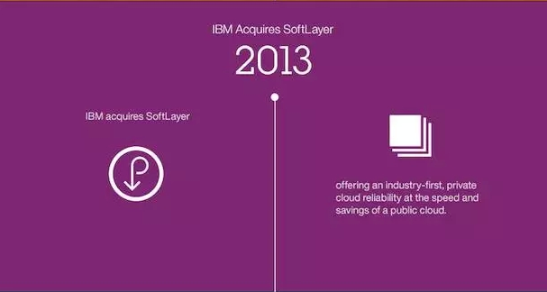
Reliability Private cloud
Notes:
2013年 IBM收购SoftLayer
IBM收购SoftLayer，提供业界领先的私有云可靠性，却具有公共云的速度和节省成本的优点。

Slide 24
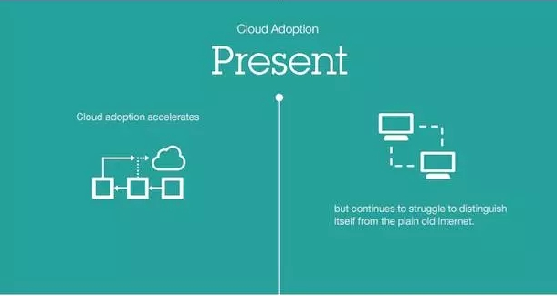
Cloud adoption
Notes:
现在 云采用
云采用加快步伐，但是继续在努力让自己有别于老式互联网。

Slide 25
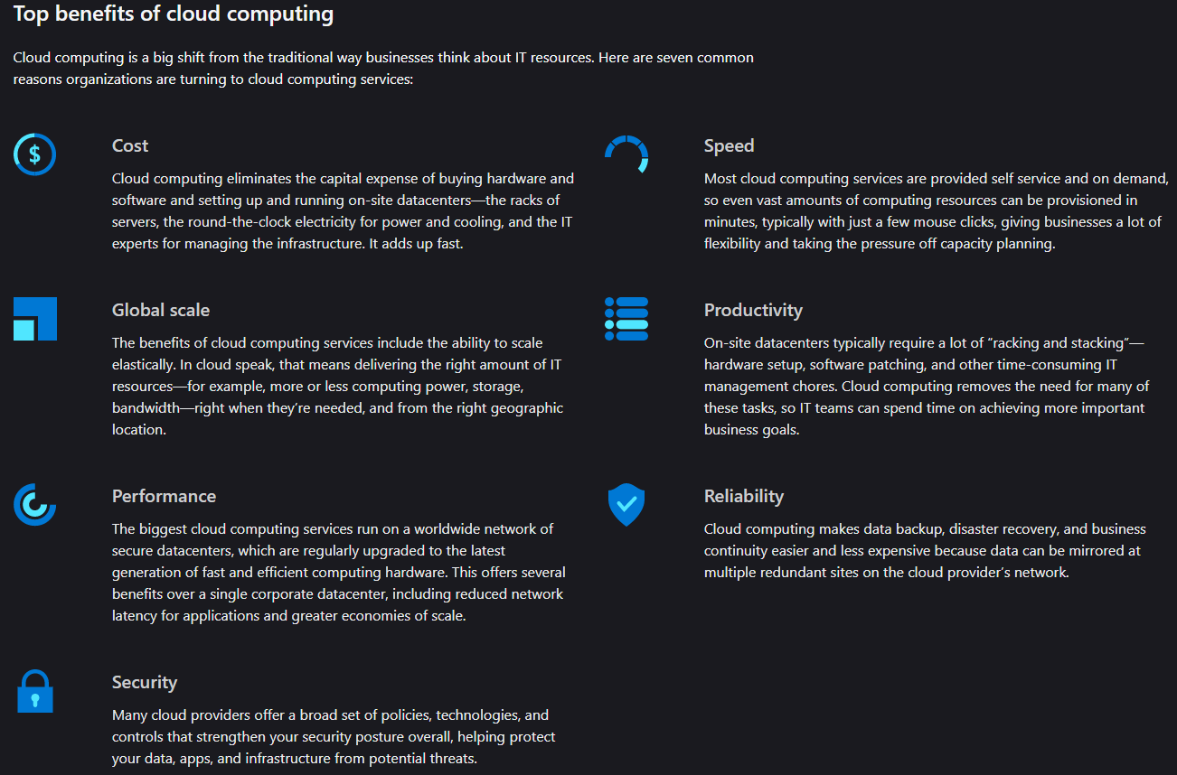
Benefits

Slide 26

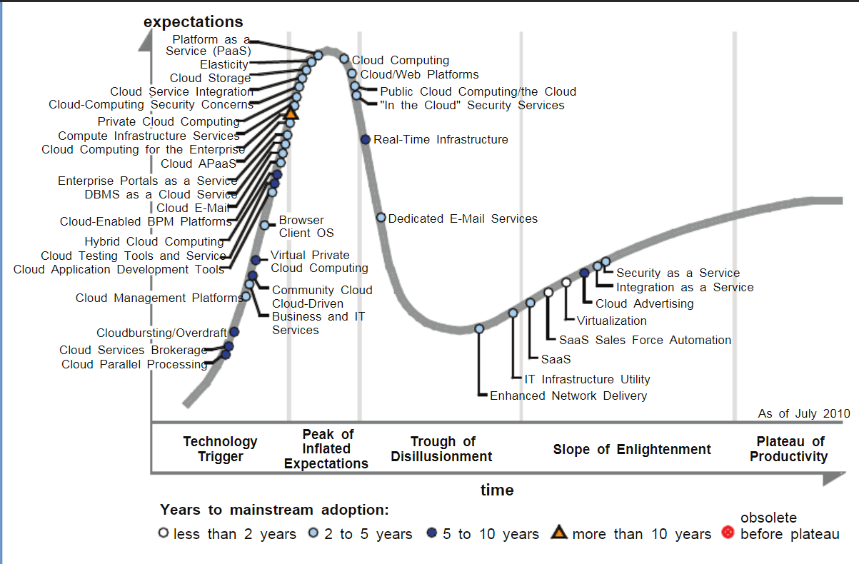

Slide 27
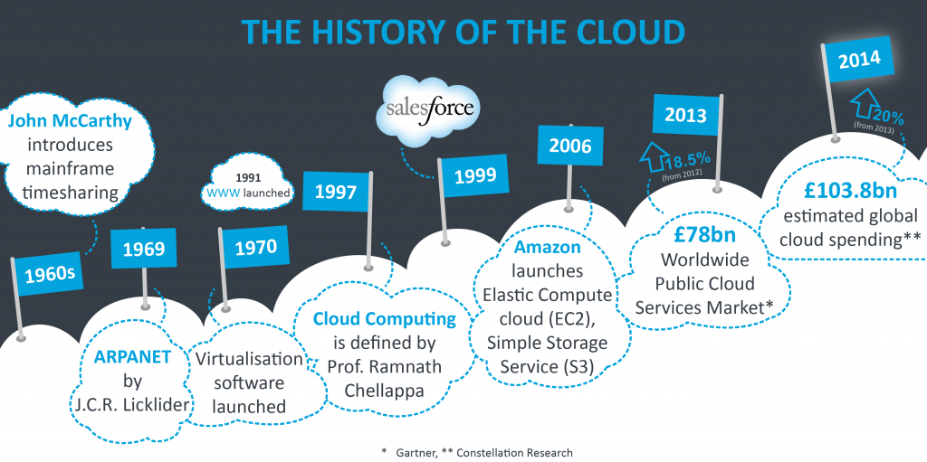
Notes:
Salesforce, CRM—SaaS模式
2005年，雅虎以10亿美元现金和中国雅虎的全部资产，换来阿里巴巴集团40%股份。
IaaS
Announcing Amazon Elastic Compute Cloud (Amazon EC2) - beta
Posted On: Aug 24, 2006
Amazon Elastic Compute Cloud (Amazon EC2) is a web service that provides resizable compute capacity in the cloud. It is designed to make web-scale computing easier for developers. Just as Amazon Simple Storage Service (Amazon S3) enables storage in the cloud, Amazon EC2 enables “compute” in the cloud. Amazon EC2’s simple web service interface allows you to obtain and configure capacity with minimal friction. It provides you with complete control of your computing resources and lets you run on Amazon’s proven computing environment. Amazon EC2 reduces the time required to obtain and boot new server instances to minutes, allowing you to quickly scale capacity, both up and down, as your computing requirements change. Amazon EC2 changes the economics of computing by allowing you to pay only for capacity that you actually use.
Amazon Simple Storage Service (Amazon S3) - Continuing Successes
Posted On: Jul 11, 2006
La Nacion, Microsoft, and SmugMug represent the breadth of companies choosing to use the web scale storage offered by Amazon S3. Global enterprises like Microsoft are using Amazon S3 to dramatically reduce their storage costs without compromising scale or reliability. On the opposite end of the spectrum, small businesses that depend on storage, such as SmugMug, are using Amazon S3’s benefits of scale and cost-efficiency that were previously only available to large companies. Amazon continues to use Amazon S3 for its own business as well, recently launching new digital initiatives that store and retrieve large data files using Amazon S3. Go to http://www.amazon.com/pr to read other press releases.
2008年1月，Hadoop成功上位，正式成为Apache基金会的顶级项目。
同年2月，Yahoo宣布建成了一个拥有1万个内核的Hadoop集群，并将自己的搜索引擎产品部署在上面。
7月，Hadoop打破世界纪录，成为最快排序1TB数据的系统，用时209秒。
此后，Hadoop便进入了高速发展期，直至现在。
2008年，Google App Engine，PaaS
2008年4月9日国际报道Google周一晚间宣布推出一个AppEngine服务，希望借此吸引软件开发人员与企业。
其中包括BigTable的资料存储处理服务，以及登入认证服务，以及可让系统处理通讯的e-mail服务。
2009年 VMware、微软和思杰都发布了新的服务器虚拟化产品，对市场产生了显著影响。
思杰在2009年10月开源Xen虚拟化平台
EARLY 1960S
The computer scientist John McCarthy, come up with concept of timesharing, and enabling Organization to simultaneously use an expensive mainframe. This computing is described as a significant contribution to the development of the Internet, and a pioneer of Cloud computing.
IN 1969
The idea of an “Intergalactic Computer Network” or “Galactic Network” (a computer networking concept similar to today’s Internet) was introduced by J.C.R. Licklider, who was responsible for enabling the development of ARPANET (Advanced Research Projects Agency Network). His vision was for everyone on the globe to be interconnected and being able to access programs and data at any site, from anywhere.
IN 1970
Using virtualization software like VMware. It become possible to run more than one Operating System simultaneously in an isolated environment. It was possible to run a completely different Computer (virtual machine) inside a different Operating System.
IN 1997
The first known definition of the term “Cloud Computing” seems to be by Prof. Ramnath Chellappa in Dallas in 1997 – “A computing paradigm where the boundaries of computing will be determined by economic rationale rather than technical limits alone.”
IN 1999
The arrival of Salesforce.com in 1999 pioneered the concept of delivering enterprise applications via simple website. The services firm covered the way for both specialist and mainstream software firms to deliver applications over the Internet.
IN 2003
The first public release of Xen, which creates a Virtual Machine Monitor (VMM) also known as a hypervisor, a software system that allows the execution of multiple virtual guest operating systems simultaneously on a single machine.
IN 2006
In 2006, Amazon expanded its cloud services. First was its Elastic Compute cloud (EC2), which allowed people to access computers and run their own applications on them, all on the cloud. Then they brought out Simple Storage Service (S3). This introduced the pay-as-you-go model to both users and the industry as a whole, and it has basically become standard practice now.
IN 2013
The Worldwide Public Cloud Services Market totalled £78bn, up 18.5 per cent on 2012, with IaaS (infrastructure-as-a-service) the fastest growing market service.
IN 2014
In 2014, global business spending for infrastructure and services related to the cloud will reach an estimated £103.8bn, up 20% from the amount spent in 2013 (Constellation Research).
Vision of Cloud Computing
We have seen how far Cloud computing has progressed in the short time since its initiation. Now lets have a look on what may become of Cloud computing technology in the future.
Following are few forecasts of what we might expect in the coming future of Cloud computing:
Cloud computing will become even more prominent in the coming years with rapid, continued growth of major global cloud data centres.
50% of all IT will be in the cloud within the next 5 – 10 years.
There will be a greater use of cloud technology as a whole across emerging markets such as in the BRIC countries (Brazil, Russia, India and China) as they continue to develop and progress. The uptake will be particularly evident in Asia where there is already a trend to stay on the edge of the latest technology.
Data for companies and personal use will be available everywhere in standardized formats, allowing us to easily consume and interact with one another at an even greater level.
The security and reliability of cloud computing will continue to evolve, ensuring that data will be even more secure with numerous techniques employed.
We will not even consider ‘cloud’ as the key technology, instead we will focus on the services and applications that it enables.
Combining cloud technology with the Internet of Things (IOT), Wearables and Bring Your Own Device (BYOD) will become the norm in personal and working lives, so much so that the presence of cloud technology as an enabler will be overlooked. An estimated 50% of organisations will require employees to use their own devices by 2017.
The total global cloud computing spend will reach $241 Billion in 2020.
The future of the cloud is far from certain. The rapid pace at which technology has changed in the last 5 years makes the next 5 near impossible to predict. However it must be said that ultimately the cloud is growing exponentially and will continue to do so for some time to come.

Slide 28

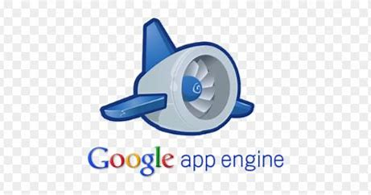

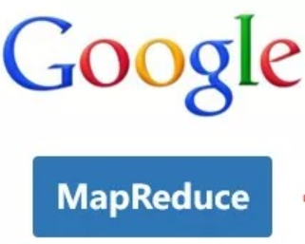


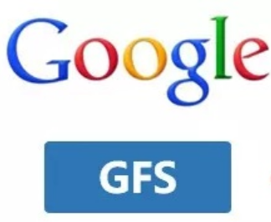
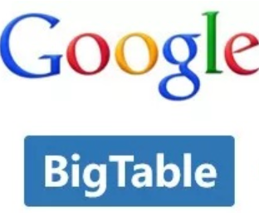
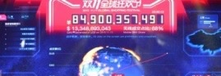

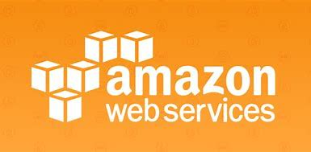
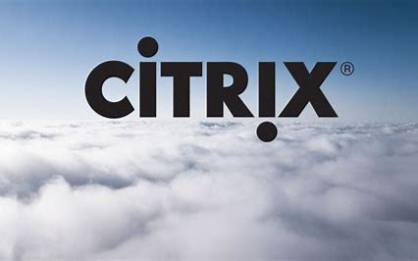
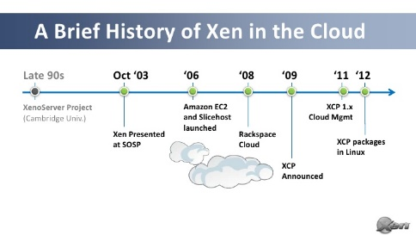
Milestones of Cloud Computing
开源云
#1
The Largest
Retail Commerce
Company Worldwide
IoT，Edge Computing
1999
2004
2008
2010
2014
2016
2018
2003
2006
2009
2013
2015
2017

Slide 29
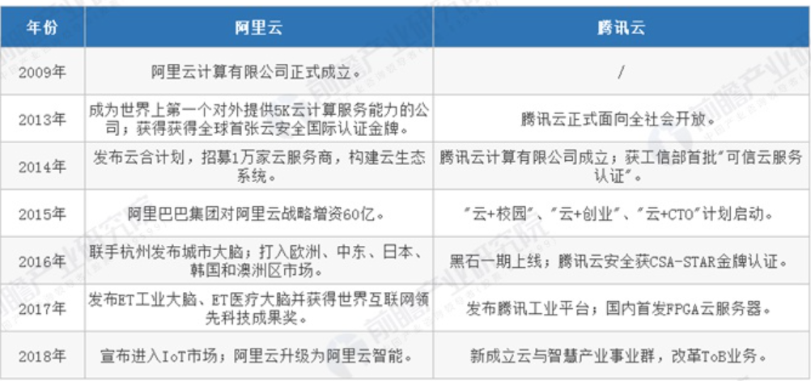

Slide 30

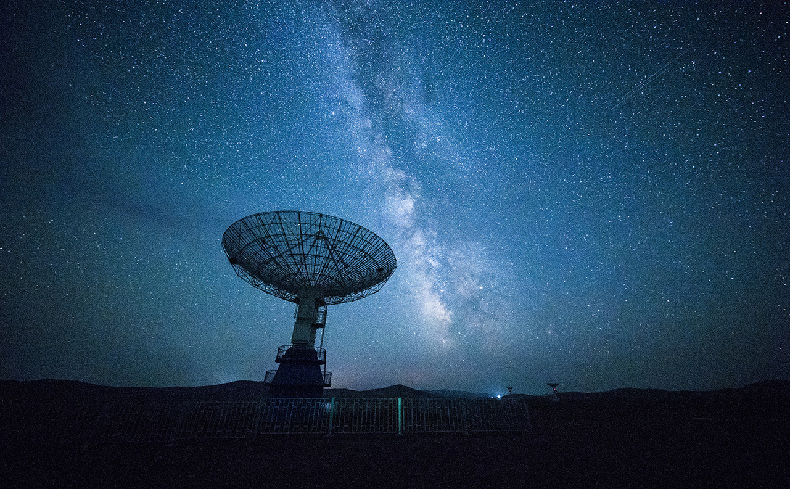
全局技术
智能产品
语音识别
人工智能
虚拟现实
Notes:
加互动，那些业务用到智能技术？？？？

Slide 31
虚拟现实的使用

Slide 32
网络技术
问题解决
算法
自动化

